Slide 1
Weekly Update 2.2
Technique of tolerance
Paper : An Intrusion-Tolerant Mechanism for Intrusion Detection Systems
Notes:
This paper is cited by : Improving the Security of Microservice Systems by Detecting and Tolerating Intrusions.

Slide 2
INTRODUCTION
An intrusion-tolerant mechanism is proposed that is built over a network intrusion detection system (NIDS).
To guarantee the NIDS detection service even in the component failure because of attacks.
This intrusion-tolerant mechanism is independent of the intrusion detection method.

Slide 3
THE NIDS FRAMEWORK OVERVIEW
Employs multiple network sensors.
Each sensor is installed on a computer and captures the traffic in the network segment.
Network traffic of the same service are fed into a specific service-based classifier. The classifier analyzes network activities, raises alerts for suspicious network behaviors, and reports them to the IDS console.
A detector is a collection of classifiers that are associated with a specific sensor.

Slide 4
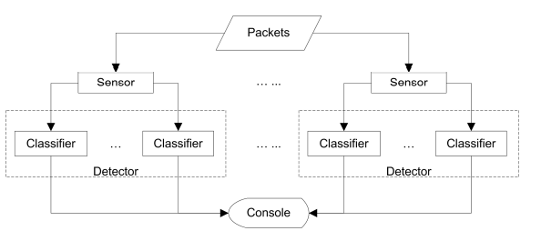
THE NIDS FRAMEWORK OVERVIEW CONT.
Over the NIDS framework, an intrusion tolerant mechanism is proposed that can tolerate the failure of detection components (classifier and detector) due to intrusions.

Slide 5
INTRUSION TOLERANCE MECHANISM
The framework consists of four components:
The Manager:Has knowledge of the resources of the NIDS and maintains system reliability by coordinating with Alert Agents (AAs) and Maintenance Agents (MAs).
Alert Agents:Responsible for monitoring the IDS components and collect intrusion alerts generated by classifiers.
Maintenance Agents:Responsible for restoring failed IDS components
The Console:Provides an interface to the security administrator to monitor the intrusion-tolerant mechanism

Slide 6
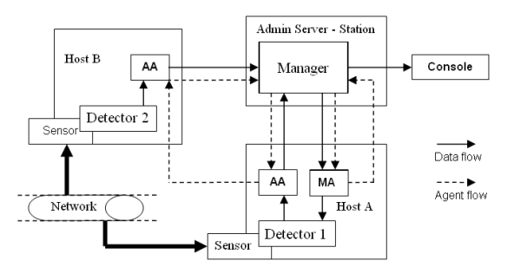
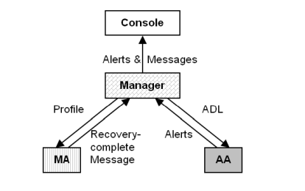
FRAMEWORK OF INTRUSION TOLERANCE MECHANISM
Notes:
ADL: Available Detection List

Slide 7
WORKFLOW OF THIS PROPOSED MECHANISM
The AA receives an Available Detection List (ADL) from the Manager.
Following the addresses in the ADL, the AA visits each detector.
The Manager receives two types of alerts from the AA: intrusion alerts(Generated by the classifiers when detecting network intrusions) and security alerts(Generated by the AA when it discovers a failed IDS component).
The MA receives the profile of the failed classifier from the Manager and restores the classifier on an operational detector.
As soon as the recovery is complete, the MA sends a recovery-complete message to the Manager. The Console receives alerts and messages from the Manager and outputs them

Slide 8
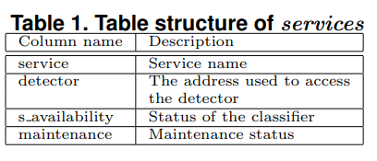
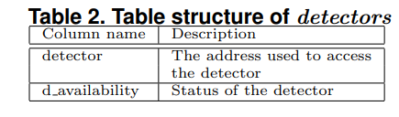
STRUCTURE OF MANAGER
A service-specific classifier consists of a profile and the CSI-KNN algorithm and detects network intrusions of some specific network service.
The Manager has two tables-services and detectors.
In the NIDS, each host has one detector and a proxy server to receive the agents (AA and MA).
The Manager receives alerts and messages through a proxy server.

Slide 9
RECOVERY TECHNIQUE
The intrusion-tolerant mechanism employs forward recovery.
Forward recovery is realized by building a new classifier on a “good” detector/
Since the restored component goes forward, it loses the information during the outage.

Slide 10
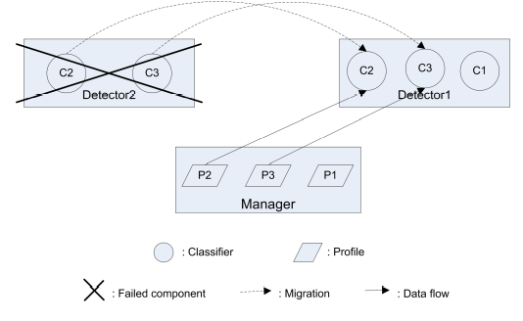
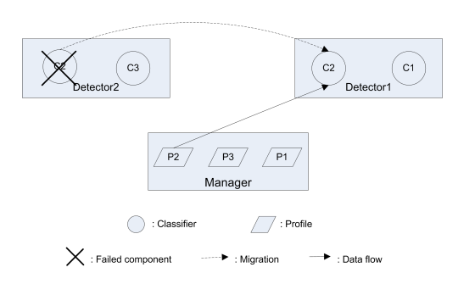
DETECTOR FAILURE & CLASSIFIER FAILURE

Slide 11

PERFORMANCE - DETECTION LATENCY
It has the drawback of information loss during the recovery.
Formula to calculate detection latency(ti is the time that the AA spends on each host, t0 is the time that the AA spends between two hosts):

Slide 12
Roadblockers
We couldn’t find any tolerance technique for containers rather most of them are related to web service security.

Slide 13
THANK YOU

